Slide 1
EMOTION DETECTION THROUGH VOICE
BDANN GAIP SUMMER’19
GROUP-4
Maaheen Jaiswal
Meha Khanna
Mehak Bindra
Pranati R
Shubh Bansal

Slide 2
Introduction
Emotions are the governing principal for humans. People express their emotions through multiple modalities.
Human speech
Facial expressions
Body pose
With the advancement in technology, human-machine communication has gone beyond straightforward legitimate calculations.
In this project, we have proposed a model to detect emotions of a person through their voice.

Slide 3
Business Application
Better voice interaction with AI
Gaming Experience
Call centres conversation
E-learning
Aircraft Pilots’ Mental Status
Voice Search
Lie detection
Helpful against child abuse
Useful in Psychotherapy

Slide 4
Analysis Process
The versatile applications of AI in voice recognition devices encouraged us to come up with this project
Input Data
Feature Extraction
Model Training
Validation & Testing
Emotion Classification
Create dataset
Extract the feature(MFCC, Decibel rel. To Peak, decibel rel. To Mean)
Train Neural Network (CNN) with the help of training data
Validation and Testing of Neural Network
Predict the emotion and display

Slide 5
Challenges:
Lack of knowledge and existing literature about voice features and analysis.
Availability of labelled data for speech emotion recognition due to issues surrounding data collection and data annotation.
The classes are not mutually exclusive.(eg. Angry /Disgusted)
Male and female emotions are expressed differently.
Alignment of language and culture create discrepancy in the perception of emotions.

Slide 6
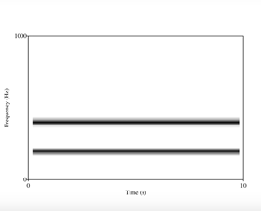
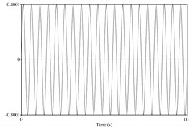
Data Exploration
Data Visualisation Techniques used: (Using Praat)
Waveforms(2D) 2. Spectrograms(3D)

Slide 7
EMOTIONS AND PARAMETERS TO DETECT THEM
 | NEUTRAL | CALM | HAPPY | SAD | ANGRY | FEARFUL | DISGUST | SURPRISED
AVERAGE/MEAN PITCH | MODERATE | MODERATE | HIGH | SLIGHTLY LOW | VERY HIGH | VERY HIGH | LOW | HIGH(MAYBE VERY HIGH)
PITCH RANGE | NARROW | NARROW | WIDE | NARROW | WIDE | WIDE | SLIGHTLY WIDER | WIDE
INTENSITY | NORMAL | LOW | HIGH | LOW | HIGH | NORMAL | LOW | HIGH
BREAKS | AVERAGE | SLIGHTLY MORE | VERY LESS | MORE | VERY LESS | MORE | AVERAGE | LESS

Slide 8
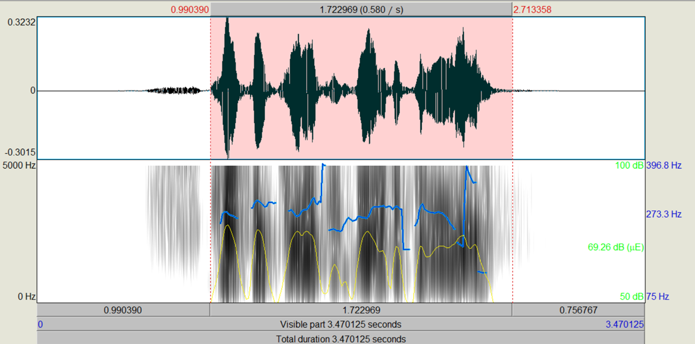
EXAMPLE 1: EMOTION-HAPPY
Mean pitch: 249.297 Hz
Pitch Range:261.785
Standard deviation: 59.448 Hz
Intensity:57.381 dB

Slide 9
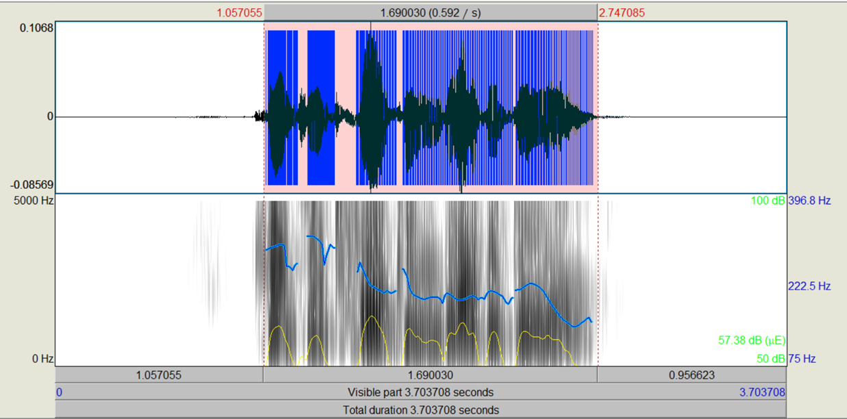
EXAMPLE 2: EMOTION-HAPPY
Mean pitch: 222.526 Hz
Pitch Range:169.304
Standard deviation: 43.219 Hz
Intensity:58.291 dB

Slide 10
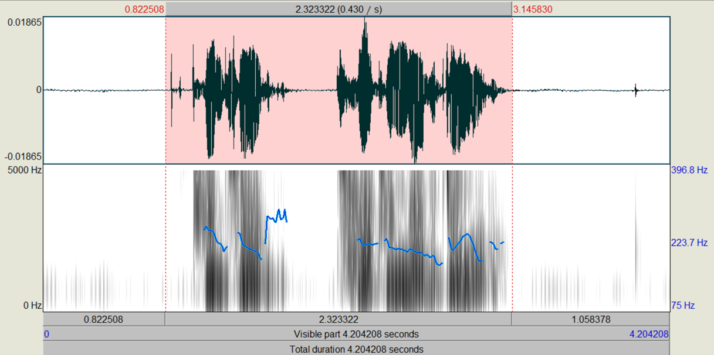
EXAMPLE 3: EMOTION-SAD
Mean pitch: 196.50 Hz
Pitch Range:119.836
Standard deviation: 26.319 Hz
Intensity:38.309 dB

Slide 11
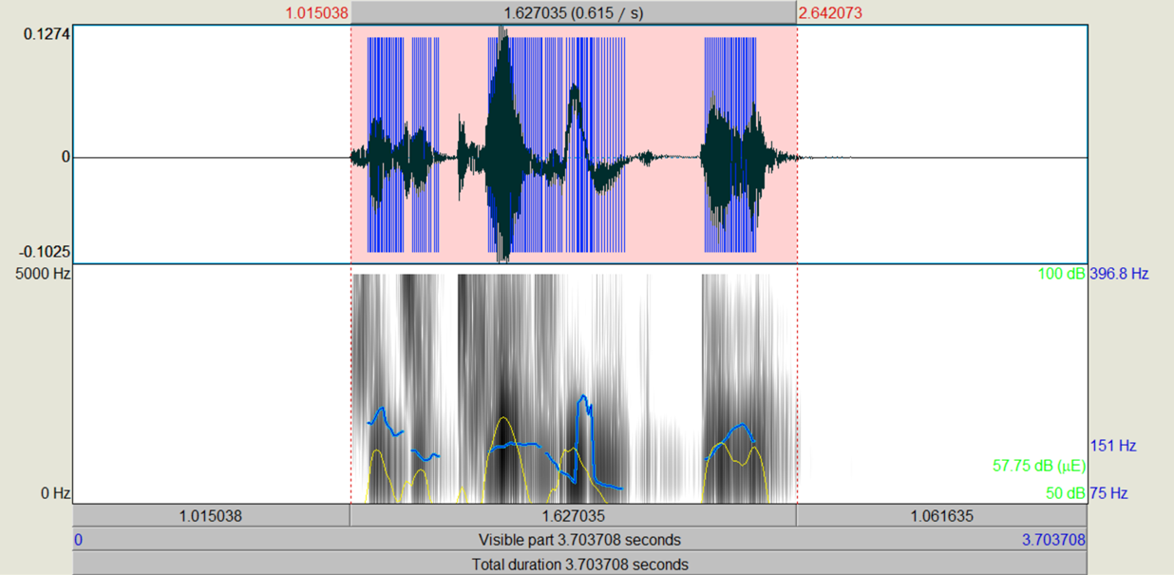
EXAMPLE 4: EMOTION-SAD
Mean pitch: 150.972 Hz
Pitch Range:110.005
Standard Deviation: 31.266 Hz
Intensity:40.807 dB

Slide 12
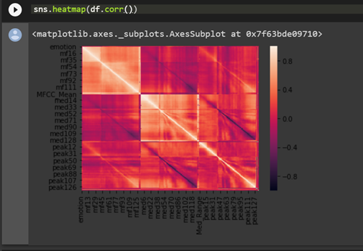
HEATMAP FOR CORRELATION BETWEEN THE FEATURES

Slide 13
Data Preparation
Dataset:
RAVDESS
24 actors(both male and female)
8 emotions
Data Cleaning: Noise removal, trimming.
Features Used:
MFCC Coefficients
Decibels relative to peak value
Decibels relative to median value
Pitch

Slide 14
MFCC
The Mel-frequency cepstrum (MFC) is a representation of the short-term power spectrum of a sound, based on a linear cosine transform of a log power spectrum on a nonlinear mel scale of frequency.

Slide 15
MFCC Calculation:
Step 1
Step 2
Step 3
Step 4
Step 5
Take the fourier transform of the signal.
Map the powers of the spectrum obtained above to the mel scale.
Take the logs of the power at each of the mel frequency.
Take the discrete cosine transform of the list of the mel log powers.
The mfcc are the amplitudes of the resulting spectrum.

Slide 16
Modeling
CNN : Traditionally used for images, we have applied a 18 layer CNN on audio features such as MFCC and Peak Amplitudes
Max-pooling: To extract the most important low level features
Activation function: ReLU (introduces sparsity and reduces likelihood of vanishing gradient)
Dense layer
Softmax at the final layer : To generate a probability for each emotion
Loss: Categorical cross-entropy
Dropout: 0.1

Slide 17
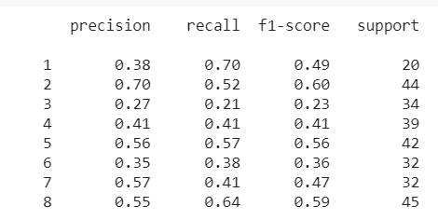
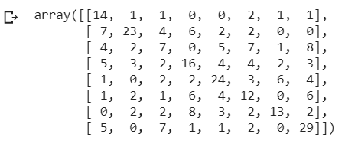
Evaluation
Confusion matrix Precision,Recall,F1-score,Support

Slide 18
Comparison with other established models
Xianglin et al. has been performed emotion classification using GMM and obtained the recognition rate of 59% for best features .
M. Khan et.al. performed emotion classification using K-NN classifier average accuracy 71.71% forward feature selection while SVM classifier has accuracy of 76.57%.
The classification rate achieved by ANN based classifiers for speaker dependent recognition with accuracy of 51.19% and for speaker independent recognition with 52.87% accuracy.
Sources
D. Ververidis and C. Kotropoulos, "Emotional Speech Recognition: Resources, Features and Methods", Elsevier Speech communication, vol. 48, no. 9, pp. 1162- 1181, September, 2006.
M. E. Ayadi , M. S. Kamel , F. Karray, “Survey on Speech Emotion Recognition: Features, Classification Schemes, And Databases”, Pattern Recognition 44, PP.572-587, 2011.

Slide 19
Discussion & Conclusion
In order to power natural human-machine communications, systems need to make sense of emotive display in humans and respond appropriately.
Further improvement could include implementing RNN.
Humans use multiple channels to display emotions, and our emotion display is not uniform - sometimes we rely more on the face, other times we display more through our voice, or even our gestures and body movements.
We need to pair facial features along with voice features to better understand the emotions.

Slide 20
Future?

